Slide 1
Primary care screening for early childhood problems and caregiver depression
Elise Fallucco, MD
Child and Adolescent Psychiatrist, Board-Certified
Physician Scientist, Nemours Center for Healthcare Delivery Science
May – June 2014

Slide 2
Gratitude and Disclosures
Mary Margaret Gleason, MD, FAAP; Tulane Institute of Infant and Early Childhood Mental Health
Mini Tandon, DO; Washington University Department of Psychiatry, Director, Preschool Clinic at BJCBH
Emma Robertson-Blackmore, PhD; Dept Psychiatry, UF-Jax
Steven Cuffe, MD; Chair, Dept of Psychiatry, UF-Jax
Amanda Lochrie, PhD, ABPP and
Holly Antal, PhD, ABPP; Nemours Children’s Clinic, Div Psychology
Chelsea Kozikowski, BA; Carolina Bejarano, BS; Robin Landy
Notes:
Add PCP champions here, too

Slide 3
Overview
I –Why screen for early childhood problems and caregiver depression?
II – How to screen using the Early Childhood Screening Assessment (ECSA)
III – Interpreting the ECSA
Case examples
“ABCs” for evaluating preschool behavior problems
IV – When/where to refer

Slide 4
I - Why screen for early childhood problems?
They are common and cause impairment
Child care expulsion, family stress and parental guilt, increased risk of child maltreatment, family suffering
Egger H, Angold A. J. Child Psychol. Psychiatry. 2006.
Notes:
Imagine overall + screen 7-10% depending upon setting based on PSC (Little and Jellinek )
Family stress – lack of sleep, parental self-blame/conflict, less opportunities to use extended family/friend support

Slide 5
Why screen for early childhood problems?
The problems persist
Majority of kids with emotional/behavioral problems will continue to have impairment up to 4 years later
If identified and treated, problems respond to appropriate interventions
Parent-Child Interaction Therapy
Parent Management
Briggs-Gowan M, Carter A. Pediatrics. 2008.
Hoagwood K, Burns BJ, Kiser L, Ringeisen H, Schoenwald SK. Psych Serv. 2001
Lavigne J, Gibbons R, Christoffel K, Arend R. Journal of Am Acad Child & Adolesc Psychiatry. 1996.
Lenze SN, Pautsch J, Luby J. Depress. Anxiety. 2011

Slide 6
Why screen for caregiver depression?
Depressive symptoms common among moms of young children (6-17%)
Depression negatively affects child development
higher risk of cognitive, social/emotional developmental delays, behavioral problems, accidents, poor safety practices
Maternal depression persists
If identified, depression responds to treatment
Chung E. Pediatrics. 2004; Giles L, Davies M, Whitrow M, Warin M, Moore V. Pediatrics. 2011;
Horwitz SM, Briggs-Gowan MJ, Storfer-Isser A, Carter AS. J Women’s Health. 2009; Kahn R. Pediatrics. 1999;
McLennan J. Pediatrics. 2000; Olson A, Dietrich A, Naspinsky D, et al. J Dev Behav Pediatrics. 2005;
Olson A. Pediatrics. 2006.
Notes:
Likewise, mat depression is common, impacts child devt, and is underrecognizes

Slide 7
These problems that impact child development are hidden
Parents reluctant to ask for help for children…
Majority of concerned parents do NOT independently express concerns to PCP about child behavior/mood
Or for their own depressive symptoms
Mistrust? fear of judgment
Surveillance (vs. screening) → low detection
PCPs detect only a minority of children with serious e/b problems (20% sensitivity)
PCPs under-identify mothers with high-levels of depressive symptoms (29% sensitivity)
Heneghan AM. Pediatrics. 2000.
Lavigne JV, Binns HJ, Christoffel KK et al. Pediatrics. 1993.
Sheldrick RC, Neger EN, Perrin EC. J Dev Behav Pediatrics. 2012.
Weitzman CC, Leventhal JM. Curr Opin Pediatr. 2006

Slide 8
Screening improves early identification
AAP and Bright Futures
psychosocial/behavioral assessment at well-visits,
surveillance re: parental social-emotional well-being
Screening improves early identification
Universal screening
Normalizes discussion of mental health issues
Gives caregivers a place to express concerns
 | PCP Surveillance | Universal screening
% of HIGH RISK preschoolers detected | 20.5 % | 86 %
% depressed moms detected | 29% | 92-97%
Gleason M, Zeanah C, Dickstein S. Infant Mental Health Journal. 2010; Heneghan AM. Pediatrics. 2000;
Lavigne JV, Binns HJ, Christoffel KK et al. Pediatrics. 1993. Arrol B et al, Ann Fam Med, 2010

Slide 9
II – How to screen
Early Childhood Screening Assessment (ECSA)
40-item, parent report checklist for kids 1 ½ - 5 years old
Child emotional and behavioral symptoms
Parental concerns about symptoms/behavior (+)
Parental distress and depression
3-point rating scale
Takes 5-10 mins to complete, 1-2 minutes to score
Validated (86% sensitive, 83% specific)
Interpreting the ECSA
Child score = sum of items 1- 36; 18+ elevated risk
Caregiver score = sum items 37+38; 2+ concerning
Gleason M, Zeanah C, Dickstein S. Infant Mental Health Journal. 2010.
Notes:
Compared with the DIPA: Diagnostic Interview for Preschool Age

Slide 10
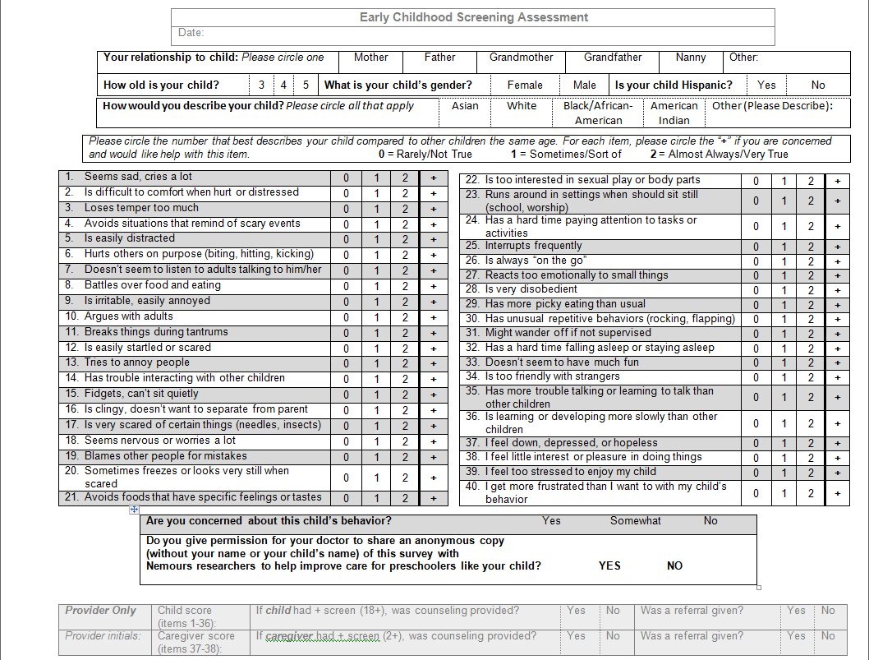

Slide 11
Workflow
Provide assessment using ECSA
Child score:
Sum Items 1-36
Caregiver score:
Sum Items 37-38
If <18:
Negative screen
If 18+:
Positive screen
If 2+:
Positive screen
Interpret findings:
Target area(s) of concern & determine severity and persistence
Interpret findings:
Assess for any child safety concerns
Interpret findings & acknowledge importance of screening
Determine whether to refer for further assessment

Slide 12
III – Interpreting ECSA Case #1 : Tommy, 4 years 1 month old
CHILD score = 14:
“2”: argues with adults, is always “on the go”
“1”: easily distracted, doesn’t listen to adults, fidgets, is clingy, runs around, interrupts, disobedient, hard time falling asleep
“+” : argues with adults, doesn’t listen to adults, disobedient
Caregiver seeks help with managing oppositional behavior
CAREGIVER depression score = 0
Caregiver stress = 2
“1”: too stressed to enjoy this child, get more frustrated than I want to with child

Slide 13
Evaluating negative screens
Discuss screen results with family and child
Address parental concerns and “+”
What are you most concerned about?
Reassure, provide anticipatory guidance
Provide resources
Incredibleyears.org, healthychildren.org
At next visit, reassess risk functioning, and symptoms

Slide 14
THE ABC’s
A = A good nights sleep
Sleep Hygiene
Ask: What time does your child go to sleep? Do they sleep independently? What is your routine?
How many hours of sleep does your child get most nights? Do they sleep in their own bed, all night, and without waking up?
Educate parents on an appropriate night’s sleep

Slide 15
THE ABC’s
B = Body (What is going into it?)
Health Hygiene
Does your child eat breakfast, lunch and dinner every day and have up to 2 snacks?
What do they drink during the day?
Are they picky eaters?
Do problem problems occur at mealtime?

Slide 16
THE ABC’s
C = Chart it
Behavior
Create a visual schedule and structure to the day
Encourage parents to create a behavior chart to track a few behavior patterns with regard to problems with sleeping, eating, and behavior throughout the day and use stickers to reinforce compliance with routine

Slide 17
Case #2 : Josh, 4 years 7 months
Ex-34 week boy w/ hx Early Steps, constipation
Mom’s complaint: “He is very high energy.. Very busy”
CHILD score = 24:
“2”: easily distracted, doesn’t listen to adults, fidgets, hard time paying attention, interrupts, always “on the go”, disobedient, might wander off
“1”: loses temper, argues with adults, trouble interacting with kids, worries, is too interested in sexual play, runs around, hard time falling asleep, too friendly with strangers
MOTHER depression score = 0
Mother stress = 2
“too stressed to enjoy child”, “get more frustrated”

Slide 18
Evaluate positive child screen
Explore symptoms and functional impairment
What bothers you the most?
Assess safety issues
Rule out trauma, impulsivity (running away)
Address environmental issues that may exacerbate disorder
Divorce, marital conflict, sibling, move
Positive screen is not diagnostic; warrants follow-up
Identifying and acknowledging challenges is helpful
Determine whether/where to refer
Notes:
Trauma – who takes care of Tommy when you are not around? Have you ever had any concerns about his safety aroudn this caregiver, any inappropriate touching or hitting? How fo you address boundaries with your child

Slide 19
Case #3 : Alexis, 3 years 3 months
CHILD score = 10:
“2”: doesn’t listen to adults, argues with adults, runs around, on the go, disobedient
MOTHER depression score = 1-2:
“1 or 2”: feel down, depressed or hopeless
Mother Stress = 4:
“2”: too stressed to enjoy this child, more frustrated than I want to with this child’s behavior

Slide 20
Evaluate positive maternal screen
Explore symptoms, functional impairment
Empathize, normalize
Discuss impact on child
Seek family and community support
Encourage caregiver to seek help
Would you be willing to get help if you knew it would help your child? (oxygen mask)
Notes:
You are your child’s world, your child’s everything, you DESERVE help

Slide 21
IV – When/Where to refer
For “positive” cases of child emotional/behavioral problems that cannot be monitored in primary care
Cross reference the list of local providers who assess and treat preschoolers (see handout)
For “positive” cases of caregiver depression
Refer to caregiver’s PCP or OB/GYN or refer to list of local providers who care for mothers/fathers

Slide 22
Summary
Problems that impact early child development are common, persistent, and underidentified
Systematic screening increases rates of identification and should improve early intervention
Screen all children at well-visits for early childhood problems using the ECSA

Slide 23
Research angle
Learn more about your practice’s experience with universal screening
Review and sign consent form in folder
Complete PCP survey
Determine frequency of caregiver-reported problems in our population
Ask caregivers to share an anonymous, de-identified copy of ECSA with study team

Slide 24
Addendum: Logistics of Screening
Inform families at check-in with “Letter to Families”
Ask parent to complete ECSA in the waiting room
Staff scores ECSA (orient staff to ECSA)
PCP reviews score before entering the room
96127 – bill for screens
If parent consent, de-identified copy of ECSA placed in study folder

